Slide 1
Risk-Aware UAV-UGV periodic Rendezvous
Guangyao Shi

Slide 2
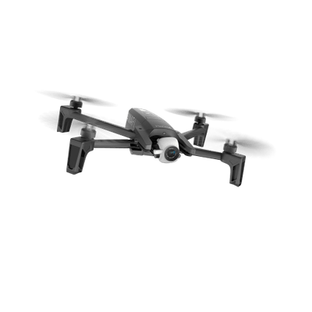
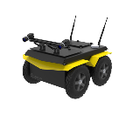




Problem 1
Given a common starting position, the objective of this problem is to find policies for the UAV and the UGV to maximize the collected reward while achieving rendezvous with a high probability before the UAV runs out of energy.
Physical map
$$b$$
Only UAV can visit
$$c$$
$$a$$
$$d$$
Cannot be directly formulated as CMDP due to non-Markovian reward structure

Slide 3
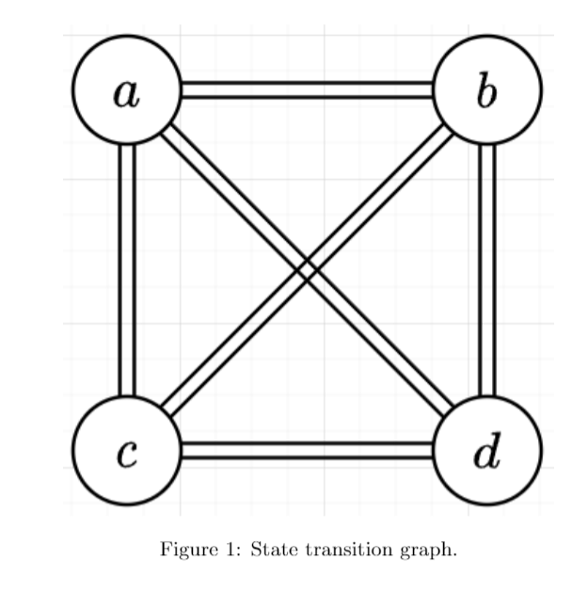
Problem
Reward-collecting type tasks: non-Markovian reward
If robot moves following a−d−c−b−d, the last transition between b and d returns zero reward
if the robot moves following a−c−b−d, it can collect some reward in the transition from b to d

Slide 4
Problem 2
Key is to rendezvous periodically for the long-term operation
Simpler problem: suppose the task path of the UGV is given, a sequence of nodes that the UAV should visit is also given. Considering the limited energy of the UAV, we want to answer the questions:
Is it possible for the UAV to finish the path by periodic rendezvous with the UGV to replenish power?
If possible, what are the detour decisions (leave a node to rendezvous with the UGV) for the UAV such that the total travel time of UAV and energy chance constrains is satisfied during the task.
detour
Notes:
Edges are straight line

Slide 5
Problem setup
Environment
UGV moves on the road
UAV can transit between any two points if energy permits
Motion models: deterministic only for rout planning
UGV moves at a speed $v∈\left[0, v_{max}^{g}\right]$
UAV moves at a speed $v∈\left[0, v_{max}^{a}\right]$
Energy model: stochastic for time-deterministic route
Task
UGV follows a sequence of nodes and may deviate from the task when receiving rendezvous request
UAV strictly follows an ordered sequence of nodes

Slide 6
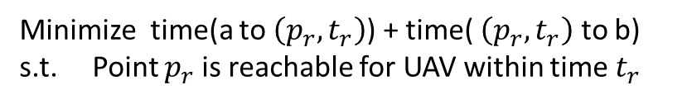



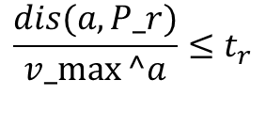
Problem setup
Cooperative behavior - rendezvous
$$c$$
detour
$$a$$
$$b$$
At node a, UAV sends a rendezvous request to UGV who is in point c
UGV will do a forward search in the road to find a rendezvous point $\left(p_{r}, t_{r}\right)$
Minimize time(a to $\left(p_{r}, t_{r}\right)$) + time( $\left(p_{r}, t_{r}\right)$ to b)
s.t. Point $p_{r}$ is reachable for UAV within time $t_{r}$
$$\frac{dis(a, P_r)}{v_max⁡^a}≤t_{r}$$

Slide 7
Problem setup
Cooperative behavior - recharge
$$c$$
detour
$$a$$
$$b$$
Swap battery -- constant time
Mobile charging -- charging time is decided by energy left and need to think about how UGV moves and its effect on the UAV task

Slide 8







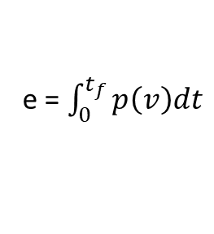
How to incorporate energy uncertainty?
$$a$$
$$c$$
Each transition is represented by a trajectory and the corresponding controller
$t_{f}∈ Ζ_{+}$
Unit second
Energy consumption distribution
We can get energy distribution for each discrete time step
Forward simulation and record a set of trajectories
e = $\int_{0}^{t_{f}}{p\left(v\right)dt}$
Compute energy

Slide 9
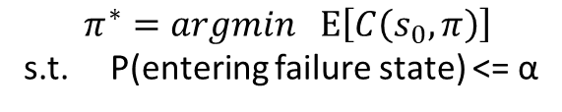
CCMDP based formulation
rendezvous
next
CCMDP:
State: UAV, UGV, energy
Action: rendezvous or next
Cost: time consumed for transition
Failure state
$$π^{∗}=argmin Ε\left[C\left(s_{0}, π\right)\right]$$
s.t. P(entering failure state) <= α

Slide 10
Problem 2
Key is to rendezvous periodically for the long-term operation
Simpler problem: suppose the task path of the UGV is given, a sequence of nodes that the UAV should visit is also given. Considering the limited energy of the UAV, we want to answer the questions:
Is it possible for the UAV to finish the path by periodic rendezvous with the UGV to replenish power?
If possible, what are the detour decisions (leave a node to rendezvous with the UGV) for the UAV such that the total travel time of UAV and energy chance constrains is satisfied during the task.
detour
Notes:
Edges are straight line

Slide 11
CCMDP based formulation
Overleaf formulation
Questions
Is this a standard CMDP?
State: UAV (discrete), UGV (discrete but large), energy(continuous)
How to solve it?
Linear programming
Dynamic programming
MCTS-based

Slide 12
CCMDP based formulation
Offline or online?
detour
Back to the original question: is it possible to finish the path for the UAV? (Offline solution can answer this by a single run)
UAV can fly for only for about 20 minutes. Does it have enough computational power to finish decision-making in a few seconds when it reaches a node?

Slide 13
Problem 2
Key is to rendezvous periodically for the long-term operation
Simpler problem: suppose the task path of the UGV is given, a sequence of nodes that the UAV should visit is also given. Considering the limited energy of the UAV, we want to answer the questions:
Is it possible for the UAV to finish the path by periodic rendezvous with the UGV to replenish power?
If possible, what are the detour decisions (leave a node to rendezvous with the UGV) for the UAV such that the total travel time of UAV and energy chance constrains is satisfied during the task.
detour
Notes:
Edges are straight line

Slide 14
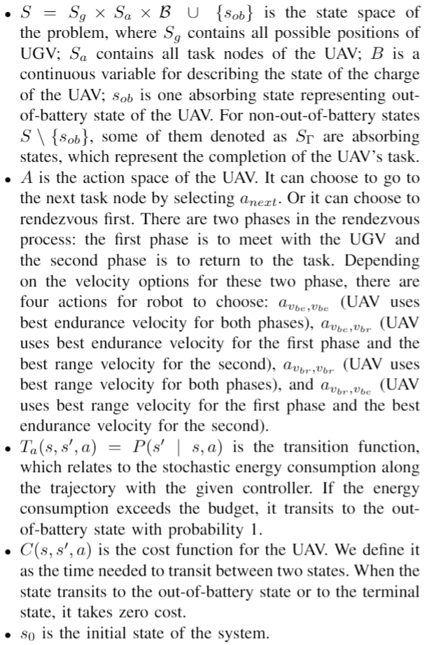
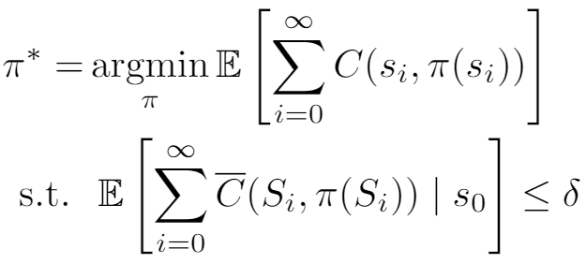
CCMDP based formulation
Overleaf formulation

Slide 15
MCTS based algorithm

Slide 16
Test case

Slide 17


Results and problems
Very risk-sensitive to collision
Less risk-sensitive to collision

Slide 18
Example 1 CMDP
Low risk
High risk

Slide 19
Different MDPs
Infinite horizon MDP
Finite horizon MDP
Indefinite MDP (e.g., stochastic shortest path)
Our problem
Chance-constrained SSP with dead ends
Constrained SSP with dead ends
A special structure and previous test case is not a good choice

Slide 20

MCTS
MCTS will converge to optimal solution under some conditions
Usually work with together with heuristic
A popular heuristic Rapid Action Value Estimation

Slide 21

Test case
Going into collision state incurs D cost

Slide 22
LP for standard CMDP – prove correctness of the formulation
Problems show up when parameters are uncertain (e.g., time varying)
Improved algorithm

Slide 23


Rendezvous example
(Top-down view)
UAV
UGV
UAV actions at each node:
Move to next task with best endurance velocity
Move to next task with best range velocity
Rendezvous with and return to task with
Rendezvous with and return to task with
Rendezvous with and return to task with
Rendezvous with and return to task with
Stochastic power consumption model
Notes:
Parameters, Input map: some file
Continuous state
Collision state penalty?

Slide 24
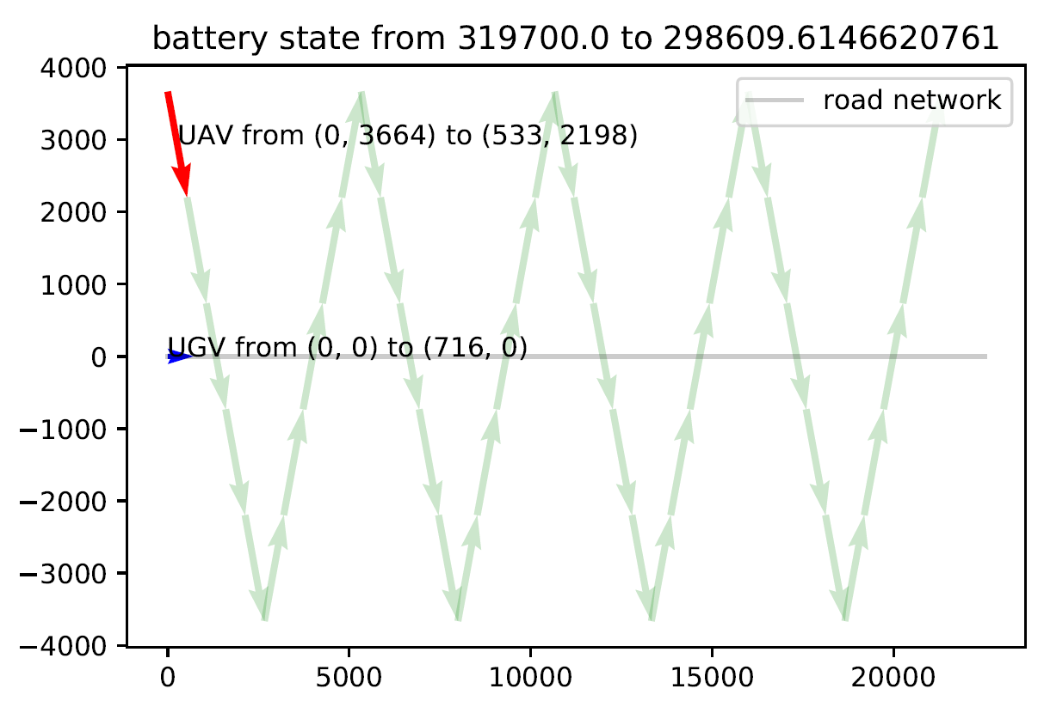
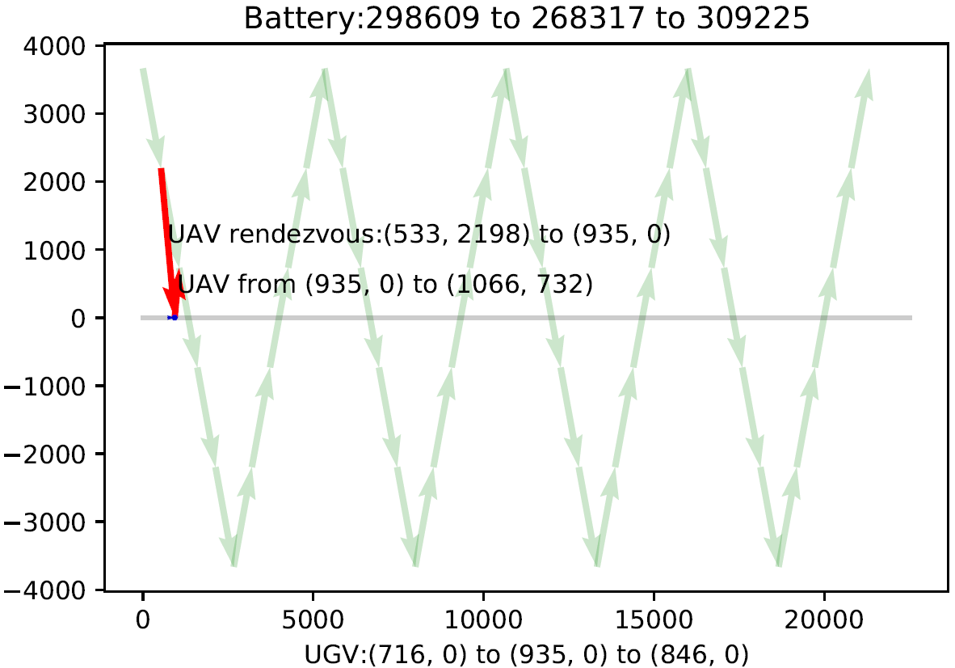
Simulation results
Notes:
Parameters, Input map: some file
Continuous state
Collision state penalty?

Slide 25

Problems with previous formulation: non-Markovian
Cannot decide transition with this state alone
Rendezvous will change UGV’s path
After rendezvous, the transition may
be non-decidable
Notes:
Parameters, Input map: some file
Continuous state
Collision state penalty?

Slide 26

Problems with previous formulation: non-Markovian
detour
Cannot decide transition with this state alone
Enforce UGV to stay on the task path and can only move forward or stay
Augment state space: UGV_next_task
Notes:
Parameters, Input map: some file
Continuous state
Collision state penalty?

Slide 27
Problem 3
given a graph, there are some rendezvous nodes in which UAV can land on UGV. UAVs will appear in those nodes stochastically due to task and energy-management and the inter-arrival time is decided by the energy consumption, which is also stochastic. UGV travels on the graph to provide power and the travel time may be stochastic for each edge. Research question is what is the minimum number of UGVs and their routes such that the waiting time of each UAV in the rendezvous nodes is less than T with high prob.

